Slide 3
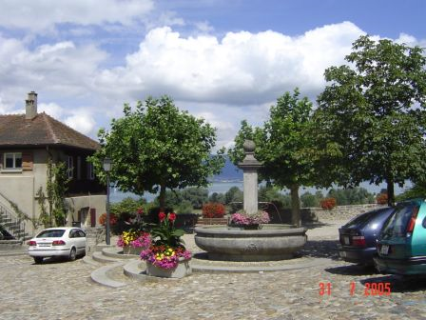
Computer Vision
Make computers understand images and video.
What kind of scene?
Where are the cars?
How far is the building?
…

Slide 4
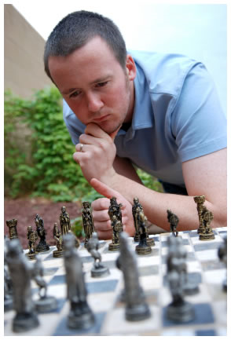
Vision is really hard
Vision is an amazing feat of natural intelligence
Visual cortex occupies about 50% of Macaque brain
More human brain devoted to vision than anything else
Is that a queen or a bishop?

Slide 5
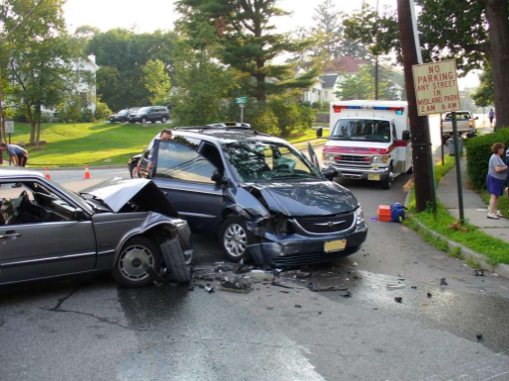
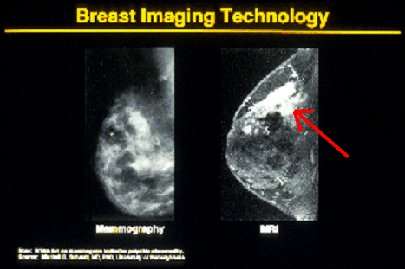
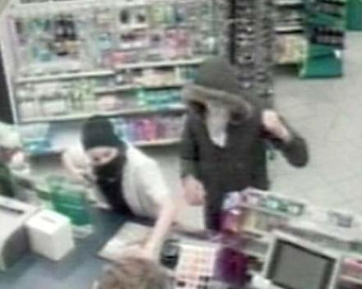
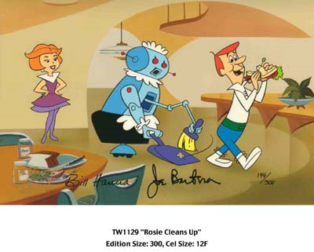
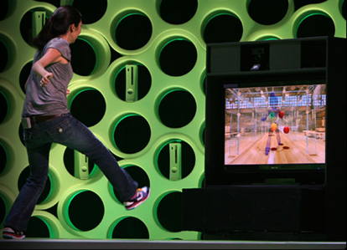
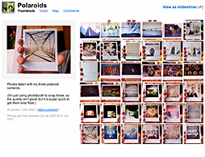
Why computer vision matters
Safety
Health
Security
Comfort
Fun
Access

Slide 6
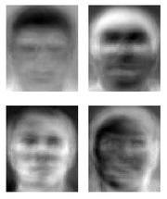
Ridiculously brief history of computer vision
1966: Minsky assigns computer vision as an undergrad summer project
1960’s: interpretation of synthetic worlds
1970’s: some progress on interpreting selected images
1980’s: ANNs come and go; shift toward geometry and increased mathematical rigor
1990’s: face recognition; statistical analysis in vogue
2000’s: broader recognition; large annotated datasets available; video processing starts
Guzman ‘68
Ohta Kanade ‘78
Turk and Pentland ‘91
Notes:
6

Slide 7
How vision is used now
Examples of state-of-the-art- Here are some examples which I have observed closely.
We can clearly see the bifurcation of computer vision here.
Computer vision is used in industries ranging from energy to automotive to information technology services.
Vision employs different levels of Images
BY CHIRAG SHARMA
Notes:
7

Slide 8
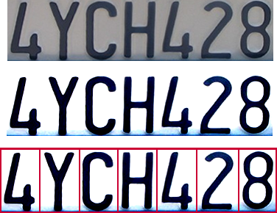

Optical character recognition (OCR)
Technology to convert scanned docs to text
If you have a scanner, it probably came with OCR software
Digit recognition, AT&T labs
http://www.research.att.com/~yann/
License plate readers
http://en.wikipedia.org/wiki/Automatic_number_plate_recognition
Notes:
8

Slide 9
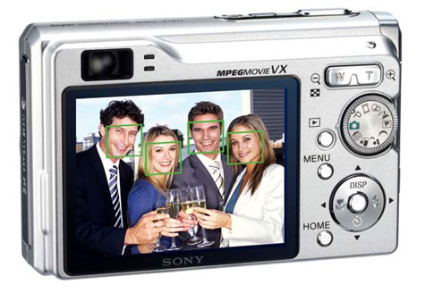
Face detection
Many new digital cameras now detect faces
Canon, Sony, Fuji, …
Notes:
9
Why would this be useful? Main reason is focus. Also enables “smart” cropping.

Slide 10
Smile detection
Sony Cyber-shot® T70 Digital Still Camera
Notes:
10

Slide 11
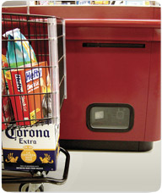
Object recognition (in supermarkets)
LaneHawk by EvolutionRobotics
“A smart camera is flush-mounted in the checkout lane, continuously watching for items. When an item is detected and recognized, the cashier verifies the quantity of items that were found under the basket, and continues to close the transaction. The item can remain under the basket, and with LaneHawk,you are assured to get paid for it… “
Notes:
11

Slide 12
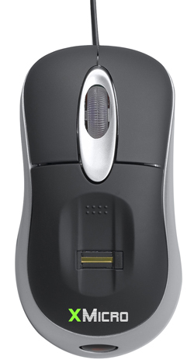

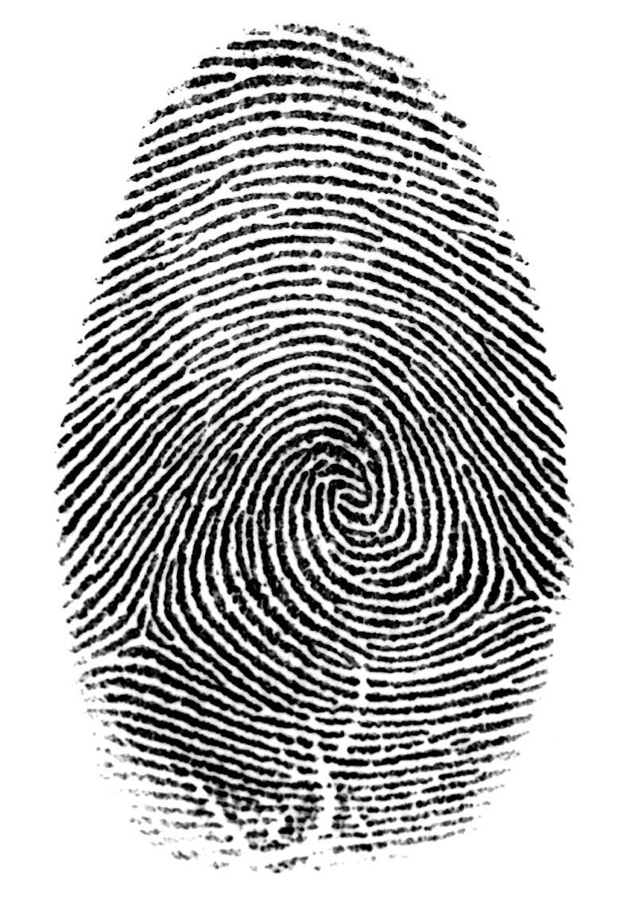

Login without a password…
Fingerprint scanners on many new laptops, other devices
Face recognition systems now beginning to appear more widely http://www.sensiblevision.com/
Notes:
12

Slide 13
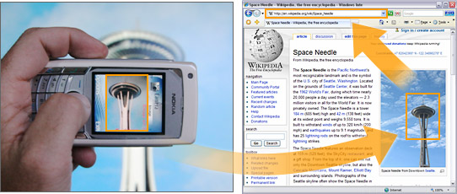
Object recognition (in mobile phones)
Notes:
13

Slide 14
COLOUR CONVERSION PHASE
void main()
{ string path = "Resources/test.png";
Mat img = imread(path);
Mat imgGray;
Mat imgBlur, imgCanny, imgDia, imgerode ;
cvtColor(img, imgGray, COLOR_BGR2GRAY); //converts input image color to gray.
This code here converts image of blue, green
And red to the gray colour.
The command cvtColor works here. It first
Takes the image (img) as destination and the
Second parameter as (imgGray) which stores
The converted image and last parameter does
The work of changing the color of the image.
There are different types of color models.
The purpose of a color model is to facilitate the specification of colors in some standard generally accepted way. In essence, a color model is a specification of a 3-D coordinate system and a subspace within that system.

Slide 15
A)VIRTUAL PAINTER
Step-1 – Importing required libraries
import numpy as np
import cv2
from collections import deque
Using the below code snippet, we will declare the BGR values of the red color, which detects the red color and helps us to draw.
Lower_red = np.array([161, 155, 84])
Upper_red = np.array([179, 255, 255])
Here i used red colour lower and upper ranges, you can try with your own color by setting BGR values
we will use a deque function, which is used to store separate colors that helps in creating buttons on the window.
bpoints = [deque(maxlen=512)]
gpoints = [deque(maxlen=512)]
rpoints = [deque(maxlen=512)]
ypoints = [deque(maxlen=512)]
Steps that I implemented :-
A)Importing libraries, assigning BGR values for color.
B)Creating a window that provides various options.
C)Capturing a video using a webcam and grabbing frames.
While Using different morphinig techniques.
D)Displaying output
bindex = 0,gindex = 0,rindex = 0,yindex = 0
colors = [(255, 0, 0), (0, 255, 0), (0, 0, 255), (0, 255, 255)]
colorIndex = 0

Slide 16
A)VIRTUAL PAINTER
cv2.putText(Window, "CLEAR ALL", (49, 33), cv2.FONT_HERSHEY_SIMPLEX, 0.5, (0, 0, 0), 2, cv2.LINE_AA)
cv2.putText(Window, "BLUE", (185, 33), cv2.FONT_HERSHEY_SIMPLEX, 0.5, (255, 255, 255), 2, cv2.LINE_AA)
cv2.putText(Window, "GREEN", (298, 33), cv2.FONT_HERSHEY_SIMPLEX, 0.5, (255, 255, 255), 2, cv2.LINE_AA)
cv2.putText(Window, "RED", (420, 33), cv2.FONT_HERSHEY_SIMPLEX, 0.5, (255, 255, 255), 2, cv2.LINE_AA)
cv2.putText(Window, "YELLOW", (520, 33), cv2.FONT_HERSHEY_SIMPLEX, 0.5, (150,150,150), 2, cv2.LINE_AA)
cv2.namedWindow('Paint', cv2.WINDOW_AUTOSIZE)
As you can see in the output we created a normal window now we need to set the webcam and place this template on the webcam video.
Step-2 – Creating a window, that provides various options.
Using the below code snippet, we will create a window that displays the different color options to draw and also it creates the buttons using cv2.putText.
Window = np.zeros((471,636,3)) + 255
Window = cv2.rectangle(paintWindow, (40,1), (140,65), (0,0,0), 2)
Window = cv2.rectangle(paintWindow, (160,1), (255,65), colors[0], -1)
Window = cv2.rectangle(paintWindow, (275,1), (370,65), colors[1], -1)
Window = cv2.rectangle(paintWindow, (390,1), (485,65), colors[2], -1)
Window = cv2.rectangle(paintWindow, (505,1), (600,65), colors[3], -1)

Slide 17
A)VIRTUAL PAINTER
Step-4 – Using different morphing techniques
Using the below code snippet, we will preprocess using the input( the text drawn on-air) using morphing techniques erode, morphologyEx, dilate.
kernel = np.ones((5, 5), np.uint8)
Mask = cv2.inRange(hsv, Lower_red, Upper_red)
Mask = cv2.erode(Mask, kernel, iterations=2)
Mask = cv2.morphologyEx(Mask, cv2.MORPH_OPEN, kernel)
Mask = cv2.dilate(Mask, kernel, iterations=1)
Using the below code snippets, we will use counters, it holds the data in an unordered collection it allows you to count the items in the iterable list.
(cnts, _) = cv2.findContours(blueMask.copy(), cv2.RETR_EXTERNAL,
cv2.CHAIN_APPROX_SIMPLE)
center = None
Step-3 – Capturing a video using a webcam and grabbing frames.
Here we are capturing the video, using a webcam so we set videoCapture to zero.
camera = cv2.VideoCapture(0)
Using the below code snippet, we will run a loop to grab the frames from the webcam and to display the dynamic results.
while True:
(grabbed, frame) = camera.read()
frame = cv2.flip(frame, 1)
hsv = cv2.cvtColor(frame, cv2.COLOR_BGR2HSV)
if not grabbed:
Break

Slide 18
A) VIRTUAL PAINTER
In the below code snippet, if counters are stored then it runs the loop. using the deque function.
if center[1] <= 65:
if 40 <= center[0] <= 140: # Clear All
bpoints = [deque(maxlen=512)]
gpoints = [deque(maxlen=512)]
rpoints = [deque(maxlen=512)]
ypoints = [deque(maxlen=512)]
bindex = 0, gindex = 0, rindex = 0,yindex = 0
paintWindow[67:,:,:] = 255
elif 160 <= center[0] <= 255:
colorIndex = 0
elif 275 <= center[0] <= 370:
colorIndex = 1
elif 390 <= center[0] <= 485:
colorIndex = 2
elif 505 <= center[0] <= 600:
colorIndex = 3
Using the below code snippet, when it detects the red color and around that color, I try to create a bounding circle.
if len(cnts) > 0:
cnt = sorted(cnts, key = cv2.contourArea, reverse = True)[0]
((x, y), radius) = cv2.minEnclosingCircle(cnt)
cv2.circle(frame, (int(x), int(y)), int(radius), (0, 255, 255), 2)
M = cv2.moments(cnt)
center = (int(M['m10'] / M['m00']), int(M['m01'] / M['m00'])

Slide 19
A)VIRTUAL PAINTER
Step-5 – Displaying output
In the below code snippet, we are implementing the draw option by taking our designed window and applying it to the webcam video.
points = [bpoints, gpoints, rpoints, ypoints]
for i in range(len(points)):
for j in range(len(points[i])):
for k in range(1, len(points[i][j])):
if points[i][j][k - 1] is None or points[i][j][k] is None:
continue
cv2.line(frame, points[i][j][k - 1], points[i][j][k], colors[i], 2)
cv2.line(paintWindow, points[i][j][k - 1], points[i][j][k], colors[i], 2)
In the below code snippet, we are displaying the output video
cv2.imshow("Web_cam_video", frame)
cv2.imshow("Paint", paintWindow)
else :
if colorIndex == 0:
bpoints[bindex].appendleft(center)
elif colorIndex == 1:
gpoints[gindex].appendleft(center)
elif colorIndex == 2:
rpoints[rindex].appendleft(center)
elif colorIndex == 3:
ypoints[yindex].appendleft(center)

Slide 20
A) VIRTUAL PAINTER
B) Automatic License/Number Plate Recognition (ANPR) with Python
Automatic License/Number Plate Recognition (ANPR/ALPR) is a process involving the following steps:
Step #1: Detect and localize a license plate in an input image/frame
Step #2: Extract the characters from the license plate
Step #3: Apply some form of Optical Character Recognition (OCR) to recognize the extracted characters
ANPR tends to be an extremely challenging subfield of computer vision, due to the vast diversity and assortment of license plate types across states and countries.
License plate recognition systems are further complicated by:
Dynamic lighting conditions including reflections, shadows, and blurring
Fast-moving vehicles
Obstructions
In the below code snippet, we are displaying the output video
cv2.imshow("Web_cam_video", frame)
cv2.imshow("Paint", paintWindow)
Conclusion
In the above implementation, we demonstrated how to create a virtual paint application using OpenCV tool.
We had given lower and upper ranges of red color. so we can use red color as a pencil to draw virtually and it reflects on your system screen.
Although my drawings are bad, it’s fun to implement.

Slide 21
License/Number Plate Recognition (ANPR) with Python
I agree that it would be nice if we had a trained object detection model, but today I want you to rise to the occasion.
Before long, I’ll be able to ditch the training wheels and consider working for a toll technology company, red-light camera integrator, speed ticketing system, or parking garage ticketing firm in which we need 99.97% accuracy.
Given these limitations, I’ll be building a basic ANPR system that anyone can use as a starting point
Additionally, large and robust ANPR datasets for training/testing are difficult to obtain due to:
These datasets containing sensitive, personal information, including time and location of a vehicle and its driver
ANPR companies and government entities closely guarding these datasets as proprietary information
Therefore, the first part of an ANPR project is usually to collect data and amass enough example plates under various conditions.
So let’s assume I don’t have a license plate dataset (quality datasets are hard to come by). That rules out deep learning object detection, which means I am going to have to exercise our traditional computer vision knowledge.

Slide 22
License/Number Plate Recognition (ANPR) with Python
# import the necessary packages
from skimage.segmentation import clear_border
import pytesseract
import numpy as np
import imutils
import cv2
class PyImageSearchANPR:
def __init__(self, minAR=4, maxAR=5, debug=False):
# store the minimum and maximum rectangular aspect ratio
# values along with whether or not we are in debug mode
self.minAR = minAR
self.maxAR = maxAR
self.debug = debug
We’re ready to start implementing our Automatic License Plate Recognition script.
I’ll keep the code neat and organized using a Python class appropriately named
PyImageSearchANPR -
. This class provides a reusable means for license plate localization and character OCR operations.
Open
anpr.py
and let’s get to work reviewing the script:

Slide 23
License/Number Plate Recognition (ANPR) with Python
Locating potential license plate candidates
Our first ANPR method helps us to find the license plate candidate contours in an image:
def locate_license_plate_candidates(self, gray, keep=5):
# perform a blackhat morphological operation that will allow
# us to reveal dark regions (i.e., text) on light backgrounds
# (i.e., the license plate itself)
rectKern = cv2.getStructuringElement(cv2.MORPH_RECT, (13, 5))
blackhat = cv2.morphologyEx(gray, cv2.MORPH_BLACKHAT, rectKern)
self.debug_imshow("Blackhat", blackhat)
Our
locate_license_plate_candidates
expects two parameters:
gray
: This function assumes that the driver script will provide a grayscale image containing a potential license plate.
keep
: We’ll only return up to this many sorted license plate candidate contours.
Debugging our computer vision pipeline –
def debug_imshow(self, title, image, waitKey=False):
# check to see if we are in debug mode, and if so, show the
# image with the supplied title
if self.debug:
cv2.imshow(title, image)
# check to see if we should wait for a keypress
if waitKey:
cv2.waitKey(0)

Slide 24
License/Number Plate Recognition (ANPR) with Python
The Scharr gradient will detect edges in the image and emphasize the boundaries of the characters in the license plate:
1)compute the Scharr gradient representation of the blackhat
2)image in the x-direction and then scale the result back to
3) the range [0, 255]
gradX = cv2.Sobel(blackhat, ddepth=cv2.CV_32F,
dx=1, dy=0, ksize=-1)
gradX = np.absolute(gradX)
(minVal, maxVal) = (np.min(gradX), np.max(gradX))
gradX = 255 * ((gradX - minVal) / (maxVal - minVal))
gradX = gradX.astype("uint8")
self.debug_imshow("Scharr", gradX)
As you can see from above, the license plate characters are clearly visible!
In our next step, we’ll find regions in the image that are light and may contain license plate characters:
1) next, find regions in the image that are light
squareKern = cv2.getStructuringElement(cv2.MORPH_RECT, (3, 3))
light = cv2.morphologyEx(gray, cv2.MORPH_CLOSE, squareKern)
light = cv2.threshold(light, 0, 255,
cv2.THRESH_BINARY | cv2.THRESH_OTSU)[1]
self.debug_imshow("Light Regions", light)

Slide 25
License/Number Plate Recognition (ANPR) with Python
these results look cluttered. The license plate region is somewhat defined, but there are many other large white regions as well. Let’s see if we can eliminate some of the noise:
# perform a series of erosions and dilations to clean up the
# thresholded image
thresh = cv2.erode(thresh, None, iterations=2)
thresh = cv2.dilate(thresh, None, iterations=2)
self.debug_imshow("Grad Erode/Dilate", thresh)
# take the bitwise AND between the threshold result and the
# light regions of the image
thresh = cv2.bitwise_and(thresh, thresh, mask=light)
thresh = cv2.dilate(thresh, None, iterations=2)
thresh = cv2.erode(thresh, None, iterations=1)
self.debug_imshow("Final", thresh, waitKey=True)
We can now smooth to group the regions that may contain boundaries to license plate characters:
# blur the gradient representation, applying a closing
# operation, and threshold the image using Otsu's method
gradX = cv2.GaussianBlur(gradX, (5, 5), 0)
gradX = cv2.morphologyEx(gradX, cv2.MORPH_CLOSE, rectKern)
thresh = cv2.threshold(gradX, 0, 255,
cv2.THRESH_BINARY | cv2.THRESH_OTSU)[1]
self.debug_imshow("Grad Thresh", thresh)

Slide 26
License/Number Plate Recognition (ANPR) with Python
In this next method, our goal is to find the most likely contour containing a license plate from our set of candidates. Let’s see how it works:
def locate_license_plate(self, gray, candidates,
clearBorder=False):
# initialize the license plate contour and ROI
lpCnt = None
roi = None
# loop over the license plate candidate contours
for c in candidates:
# compute the bounding box of the contour and then use
# the bounding box to derive the aspect ratio
(x, y, w, h) = cv2.boundingRect(c)
ar = w / float(h)
I’d say it is the second or third largest contour in the image, and I also notice the plate contour is not touching the edge of the image.
Speaking of contours, let’s find and sort them:
# find contours in the thresholded image and sort them by
# their size in descending order, keeping only the largest
# ones
cnts = cv2.findContours(thresh.copy(), cv2.RETR_EXTERNAL,
cv2.CHAIN_APPROX_SIMPLE)
cnts = imutils.grab_contours(cnts)
cnts = sorted(cnts, key=cv2.contourArea, reverse=True)[:keep]
# return the list of contours
return cnts

Slide 27
License/Number Plate Recognition (ANPR) with Python
# check to see if the aspect ratio is rectangular
if ar >= self.minAR and ar <= self.maxAR:
# store the license plate contour and extract the
# license plate from the grayscale image and then
# threshold it
lpCnt = c
licensePlate = gray[y:y + h, x:x + w]
roi = cv2.threshold(licensePlate, 0, 255,
cv2.THRESH_BINARY_INV | cv2.THRESH_OTSU)[1]
Let’s wrap up the locate_license_plate
method so we can move onto the next phase:
# check to see if we should clear any foreground
# pixels touching the border of the image
# (which typically, not but always, indicates noise)
if clearBorder:
Our
locate_license_plate
function accepts three parameters:
Gray: Our input grayscale image
candidates: The license plate contour candidates returned by the previous method in this class
clearBorder: A boolean indicating whether our pipeline should eliminate any contours that touch the edge of the image.
the aspect ratio is a relationship between the width and height of the rectangle.

Slide 28
License/Number Plate Recognition (ANPR) with Python
roi = clear_border(roi)
# display any debugging information and then break
# from the loop early since we have found the license
# plate region
self.debug_imshow("License Plate", licensePlate)
self.debug_imshow("ROI", roi, waitKey=True)
break
# return a 2-tuple of the license plate ROI and the contour
# associated with it
return (roi, lpCnt)
The central method of the PyImageSearchANPR
class –
Our final method brings all the components together in one centralized place so our driver script can instantiate a PyImageSearchANPR
object, and then make a single function call. Let’s implement find_and_ocr
:
License/Number Plate Recognition (ANPR) with Python-
roi = clear_border(roi)
# display any debugging information and then break
# from the loop early since we have found the license
# plate region
self.debug_imshow("License Plate", licensePlate)
self.debug_imshow("ROI", roi, waitKey=True)
break
# return a 2-tuple of the license plate ROI and the contour
# associated with it
return (roi, lpCnt)

Slide 29
License/Number Plate Recognition (ANPR) with Python
clearBorder=clearBorder)
# only OCR the license plate if the license plate ROI is not
# empty
if lp is not None:
# OCR the license plate
options = self.build_tesseract_options(psm=psm)
lpText = pytesseract.image_to_string(lp, config=options)
self.debug_imshow("License Plate", lp)
# return a 2-tuple of the OCR'd license plate text along with
# the contour associated with the license plate region
return (lpText, lpCnt)
This method accepts three parameters:
image: The three-channel color image of the rear (or front) of a car with a license plate tag
Psm: The Tesseract Page Segmentation mode.
clearBorder: The flag indicating whether we’d like to clean up contours touching the border of the license plate ROI
Given our function parameters, I now:
def find_and_ocr(self, image, psm=7, clearBorder=False):
# initialize the license plate text
lpText = None
# convert the input image to grayscale, locate all candidate
# license plate regions in the image, and then process the
# candidates, leaving us with the *actual* license plate
gray = cv2.cvtColor(image, cv2.COLOR_BGR2GRAY)
candidates = self.locate_license_plate_candidates(gray)
(lp, lpCnt) = self.locate_license_plate(gray, candidates,

Slide 30
License/Number Plate Recognition (ANPR) with Python
# import the necessary packages
from pyimagesearch.anpr import PyImageSearchANPR
from imutils import paths
import argparse
import imutils
import cv2
def cleanup_text(text):
# strip out non-ASCII text so we can draw the text on the image
# using OpenCV
return "".join([c if ord(c) < 128 else "" for c in text]).strip()
script’s command line arguments:-
# construct the argument parser and parse the arguments
ap = argparse.ArgumentParser()
ap.add_argument("-i", "--input", required=True,
help="path to input directory of images")
ap.add_argument("-c", "--clear-border", type=int, default=-1,
Creating our license/number plate recognition driver script with OpenCV and Python
Now that our
PyImageSearchANPR
class is implemented, we can move on to creating a Python driver script that will:Load an input image from disk
Find the license plate in the input image
OCR the license plate
Display the ANPR result to our screen
Let’s go in the project directory and find our driver file
ocr_license_plate.py:

Slide 31
License/Number Plate Recognition (ANPR) with Python
--clear-border
: A flag indicating if we’ll clean up the edges of our license plate ROI prior to passing it to Tesseract (further details are presented in the “Pruning license plate candidates” section above).
--psm
: Tesseract’s Page Segmentation Mode; a 7
indicates that Tesseract should only look for one line of text.
--debug
: A boolean indicating whether we wish to display intermediate image processing pipeline debugging images.
INITIALIZATION-
# initialize our ANPR class
anpr = PyImageSearchANPR(debug=args["debug"] > 0)
# grab all image paths in the input directory
imagePaths = sorted(list(paths.list_images(args["input"])))
IMAGEPATHS AND OCR’ING EACH OTHER –
# loop over all image paths in the input directory
for imagePath in imagePaths:
# load the input image from disk and resize it
image = cv2.imread(imagePath)
image = imutils.resize(image, width=600)
help="whether or to clear border pixels before OCR'ing")
ap.add_argument("-p", "--psm", type=int, default=7,
help="default PSM mode for OCR'ing license plates")
ap.add_argument("-d", "--debug", type=int, default=-1,
help="whether or not to show additional visualizations")
args = vars(ap.parse_args())
Our command line arguments include:
--input
: The required path to the input directory of vehicle images.

Slide 32
License/Number Plate Recognition (ANPR) with Python
box = box.astype("int")
cv2.drawContours(image, [box], -1, (0, 255, 0), 2)
# compute a normal (unrotated) bounding box for the license
# plate and then draw the OCR'd license plate text on the
# image
(x, y, w, h) = cv2.boundingRect(lpCnt)
cv2.putText(image, cleanup_text(lpText), (x, y - 15),
cv2.FONT_HERSHEY_SIMPLEX, 0.75, (0, 255, 0), 2)
# show the output ANPR image
print("[INFO] {}".format(lpText))
cv2.imshow("Output ANPR", image)
cv2.waitKey(0)
CONCLUSION- I’ve successfully applied ANPR to all of these images, including license/number plate examples on the front or back of the vehicle. But there are limitations due to foreground pixels because they touch the tesserect ocr.
REFERENCES- DATASET CURATED BY DEVIKA MISHRA FROM DATATURKS AND I HAVE USED THE SAME. WHICH IS FREELY AVAILABLE.
# apply automatic license plate recognition
(lpText, lpCnt) = anpr.find_and_ocr(image, psm=args["psm"],
clearBorder=args["clear_border"] > 0)
# only continue if the license plate was successfully OCR'd
if lpText is not None and lpCnt is not None:
# fit a rotated bounding box to the license plate contour and
# draw the bounding box on the license plate
box = cv2.boxPoints(cv2.minAreaRect(lpCnt))

